Slide 1

Product Knowledge Training Session PIBAS Products – Inquiry Options
Presented By Muhammad Asim Senior Support Analyst

Slide 2
Contents
Inquiries
Account Inquiry
Balance Inquiry
Customer Summary
Temporary Statement
Statement of Account
Account Inquiry (All Branches)
Account Interest Report

Slide 3
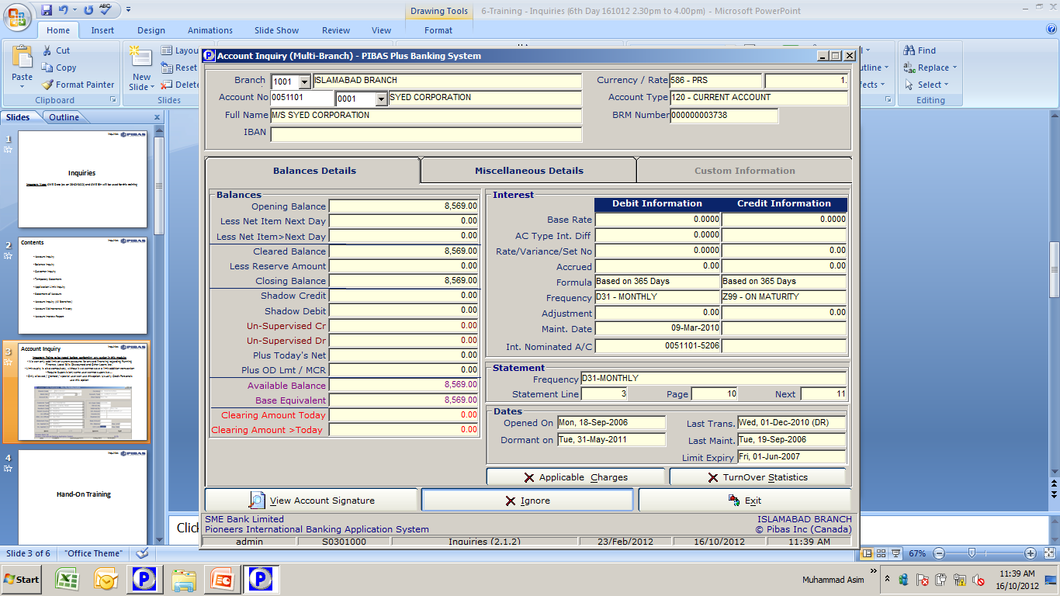
Account Inquiry
Inquiries
Important Points
We will just input basic number, all related suffixes will be appeared in drop down list.
View Account Signature is also available in this screen
Here so many important information could be viewed, i.e. Applicable Charges, Turnover Statistics, Interest / Profit Frequency, Statement Frequency, Limit Amount, Limit Expiry, Account Referred By, Related GL, Account Type, Customer Type, Special Conditions, Permanent and Postal Addresses etc.

Slide 4
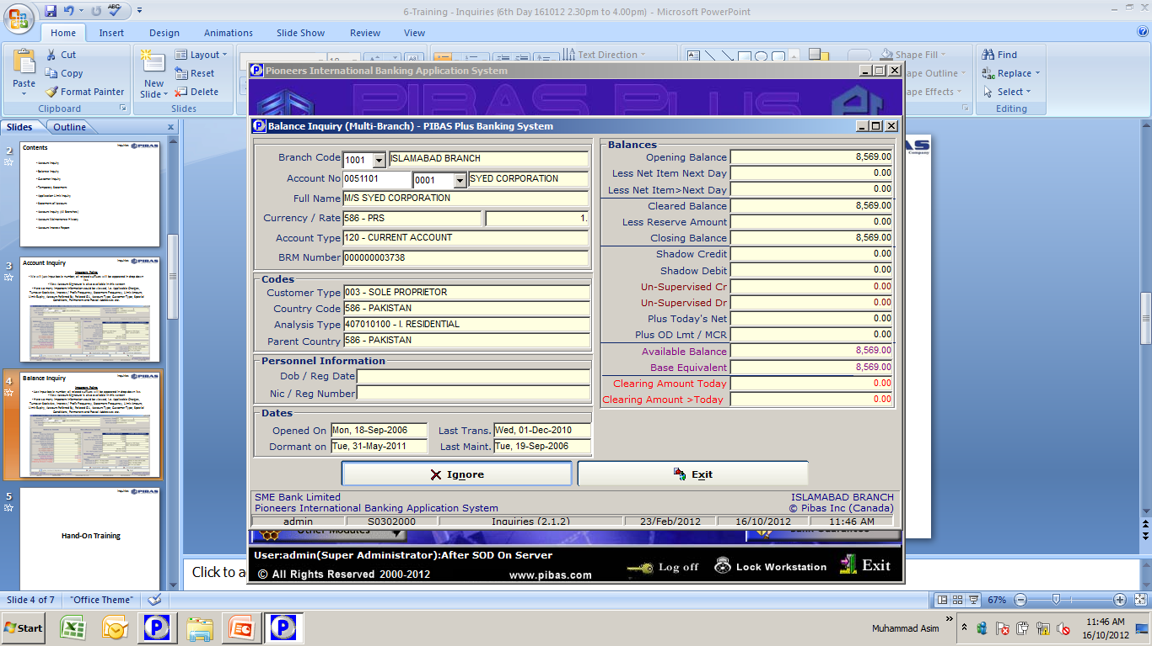
Balance Inquiry
Inquiries
Important Points
We will just input basic number, all related suffixes will be appeared in drop down list.
Here different type of information related to Balance Inquiry could be viewed i.e. Opening Balance, Shadow Credit / Shadow Debit, Un-Supervised Transactions (Dr & Cr), OD Limit, Available Balance (in actual currency), Base Equivalent, Clearing Effect, Date of Account Opening, Date of Dormancy (if any) etc.

Slide 5
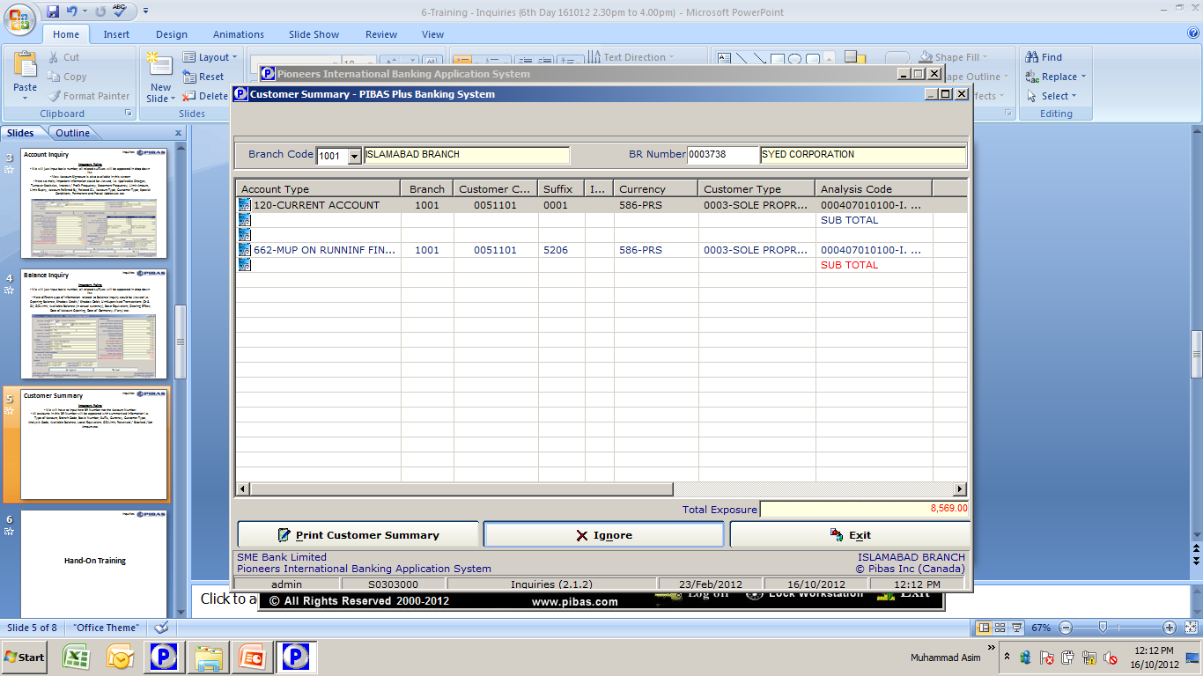
Customer Summary
Inquiries
Important Points
We will have to input here BR Number not the Account Number
All accounts in this BR Number will be appeared with summarized information i.e. Type of Account, Branch Code, Basic Number, Suffix, Currency, Customer Type, Analysis Code, Available Balance, Local Equivalent, OD Limit, Reserved / Blocked / Lien Amount etc.

Slide 6
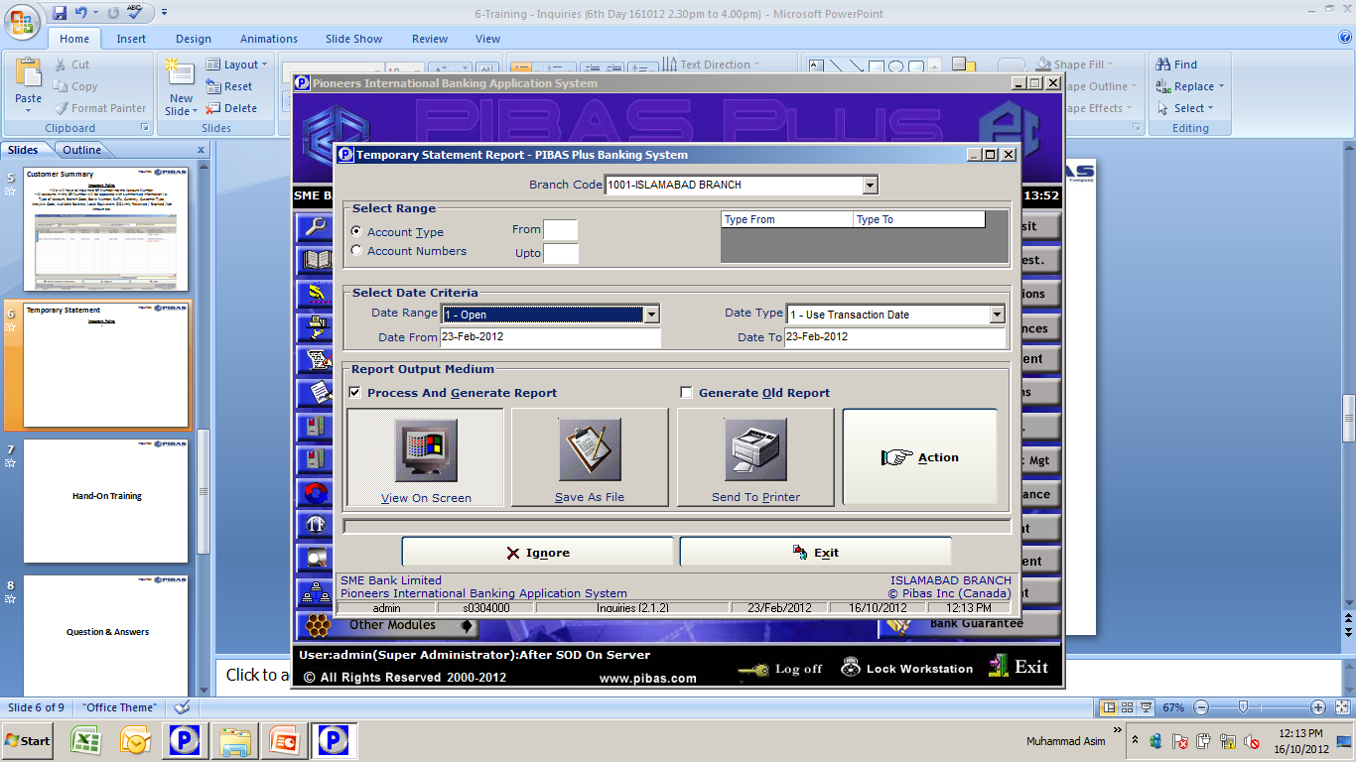
Temporary Statement
Inquiries
Important Points
Here we can generate / view / print statement of account of Customer or GL, or Account Type Range wise or Account Number Range wise.
Here two types of layout are available New and Old, if we want statement on old format so we will have to click on Generate Old Report.

Slide 7
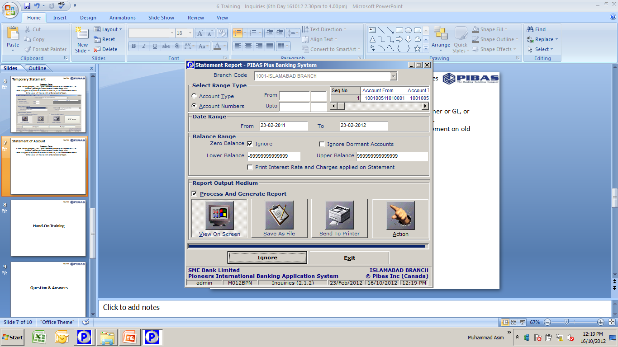
Statement of Account
Inquiries
Important Points
Here we can generate / view / print statement of account of Customer or GL, or Account Type Range wise or Account Number Range wise.
Here we can also print Interest Rate Change and Applied Charges on statement of account.
Here Lower Balance and Upper Balance facility is also available.
Here we can also ignore all dormant accounts while generating statement of account

Slide 8
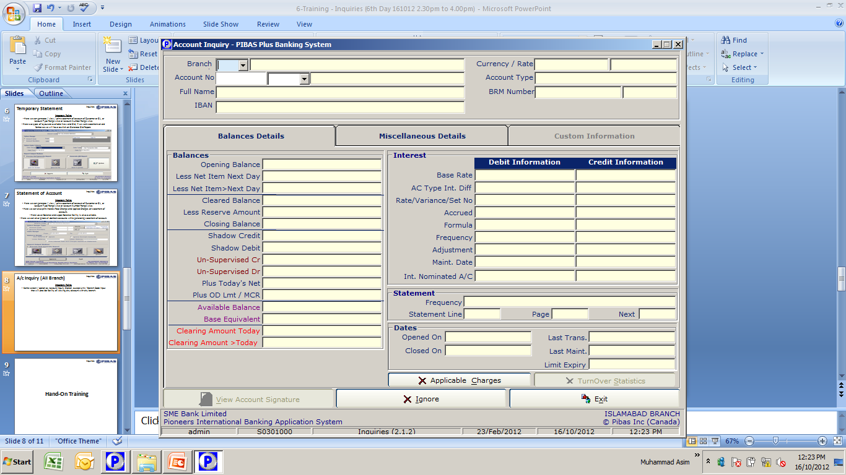
A/c Inquiry (All Branch)
Inquiries
Important Points
Same screen / option as Account Inquiry Option, except Unit / Branch Code input that will provide facility of viewing any account with any branch.

Slide 9
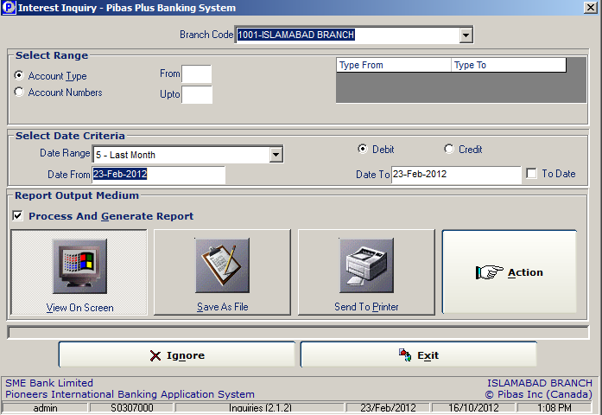
Account Interest Report
Inquiries
Important Points
This report provides the comprehensive history of Interest / Markup rate on an account

Slide 10
Inquiries
Many thanks for your active participation

